Slide 1
B8.aa
Overview of Pre-Processing
Sabah Ul-Hasan Credit: Karthik Gangavarapu, Jerry Zak

Slide 2
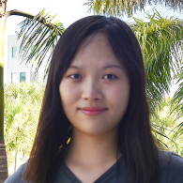

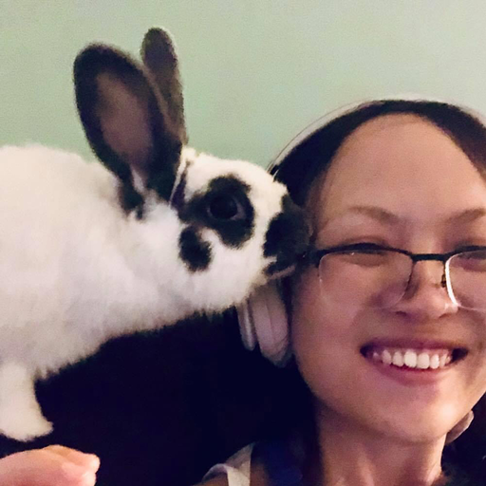
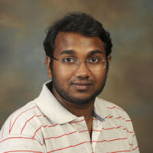
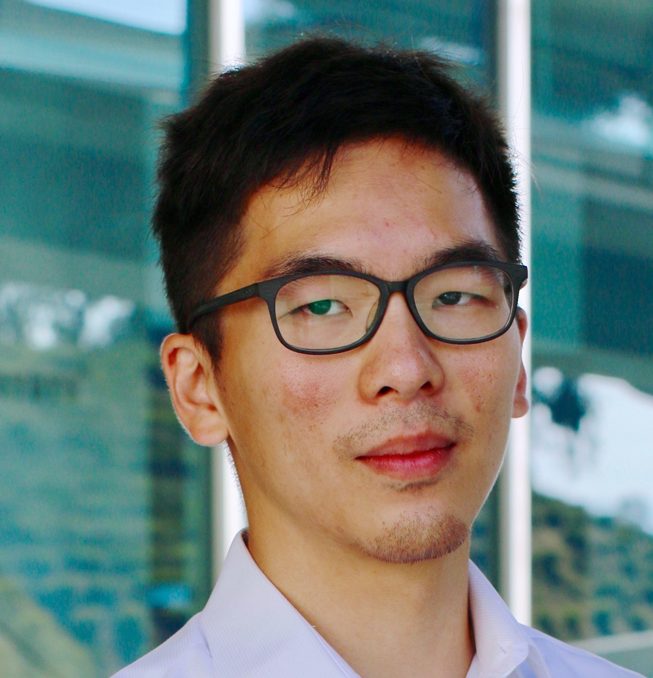
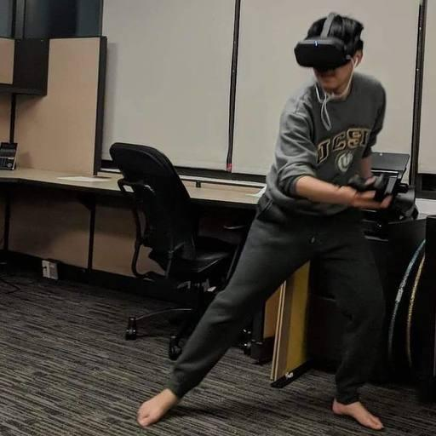
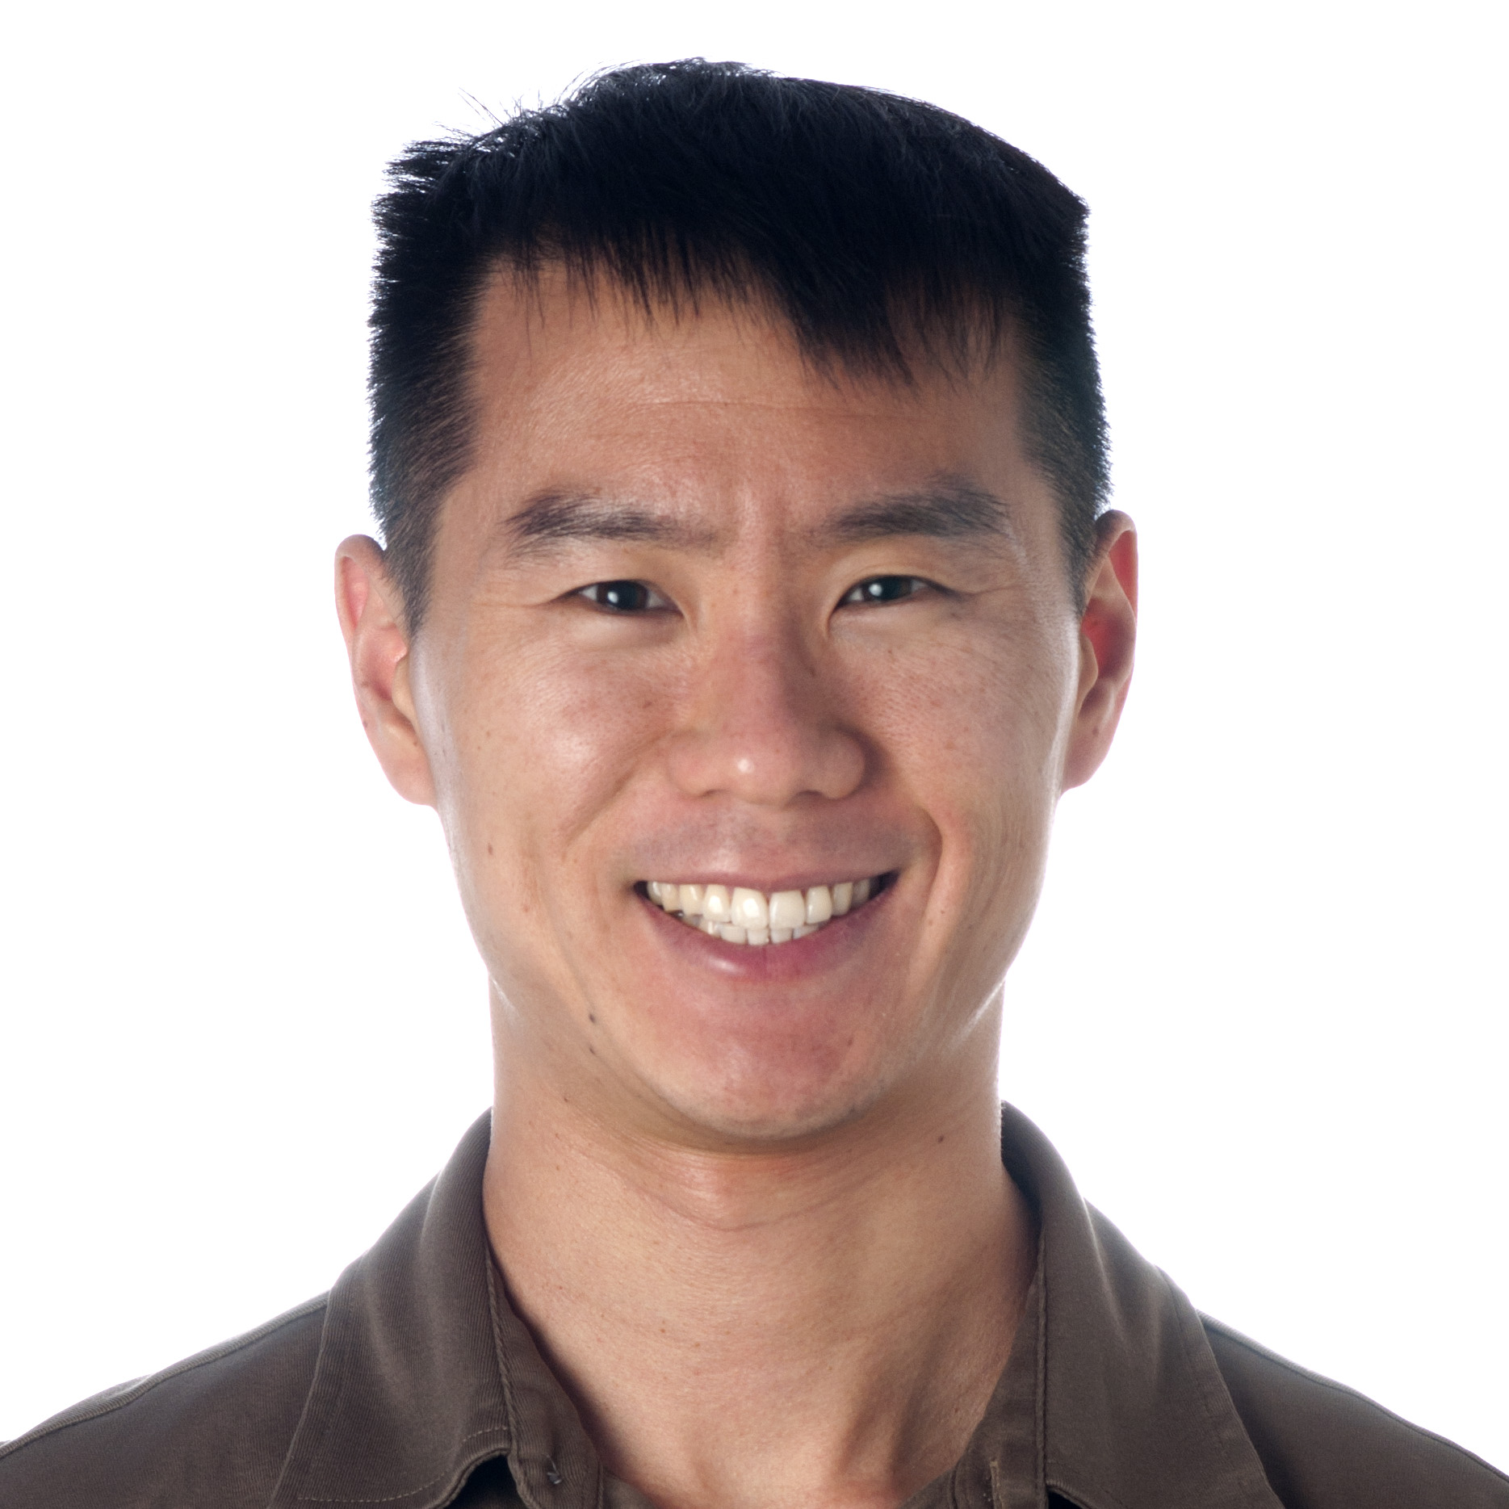
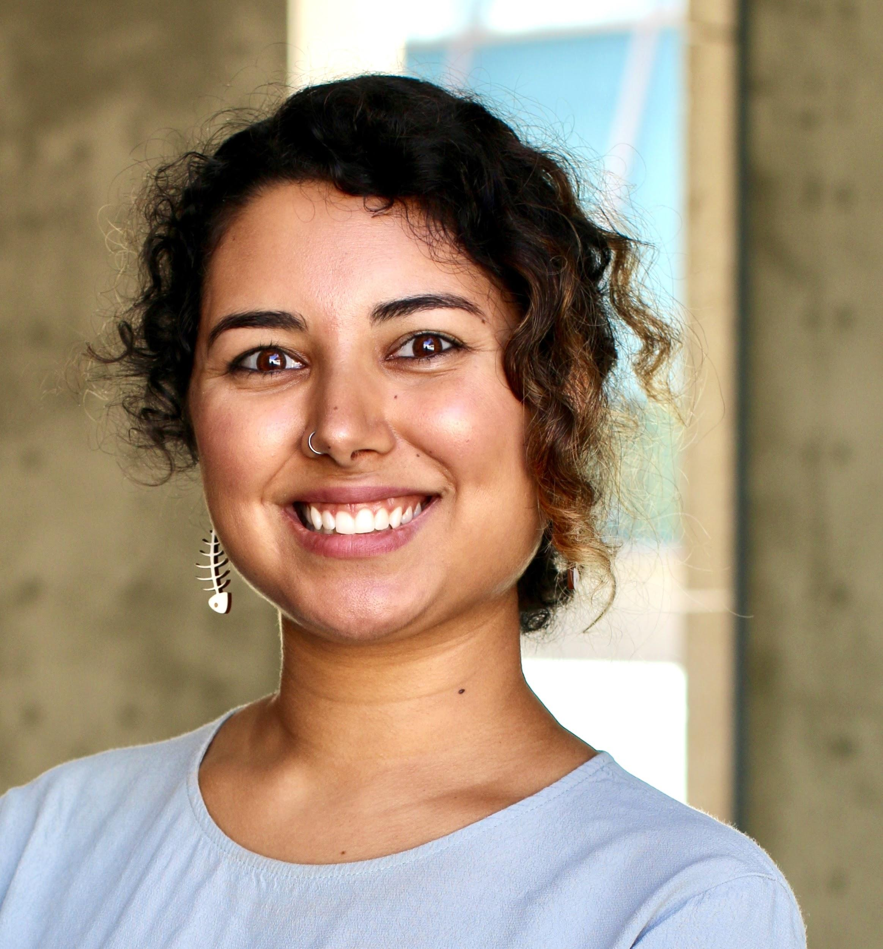
It’s a Pandemic, Afterall
Expertise
Mentorship
Professionalism
Communicative
We’re humans, too (as are you!) We’ll be decompressing during non-business hours
Support of you being your healthiest self
Huitian Dao
Karthik Gangavarapu
Shang-Fu
Chen
Andrew Su
Sabah Ul-Hasan

Slide 3
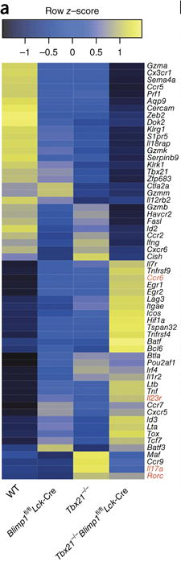
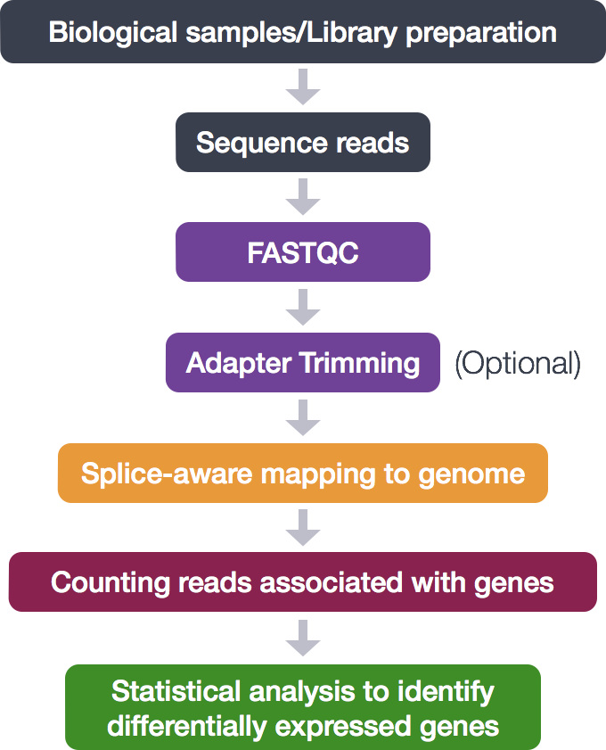
RNA-Seq Workflow
}
Bash
R
Xin et al. 2016

Slide 4
Today: Clarifying this process
Raw sequencing signal
Base called raw files
Demultiplexing
FASTQ
Alignment to reference
Differential expression analysis
Counts per feature
SAM/BAM
Variants Calling
http://homer.ucsd.edu/homer/basicTutorial/samfiles.html

Slide 5
Today: Clarifying this process, going forward
Raw sequencing signal
Base called raw files
Demultiplexing
FASTQ
Alignment to reference
Differential expression analysis
Counts per feature
SAM/BAM
Variants Calling

Slide 6

HW8: Groups of 3
5 min: Individual time to identify gaps in knowledge
What remains unclear?
30 min: Take turns sharing what about pipeline is unclear, and explaining it from a different perspective (rotate every ~5 min)

Slide 7
Altogether
10 min Common issues, and demos

Slide 8
B8.ab
Variant Calling
Sabah Ul-Hasan

Slide 9
What is variant calling?
Raw sequencing signal
Base called raw files
Demultiplexing
FASTQ
Alignment to reference
Differential expression analysis
Counts per feature
SAM/BAM
Variants Calling

Slide 10
Zoom Poll
Why do we do variant calling?
To see what genes are mapped to our genome To identify differences between SNPs To look at a differentially expressed gene All of the above
None of the above
Notes:
Want to know if you encounter unwelcoming behavior outside or inside classroom

Slide 11
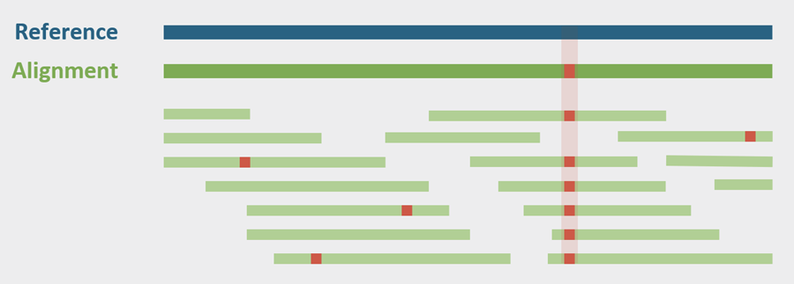
Variant calling allows us to look at polymorphisms
https://www.baseclear.com/blog/bioinformatics/baseclears-variant-detection-pipeline-renewed/

Slide 12
Zoom Poll
Why do a count matrix and variant calling?
More analysis, more information
Depends on the scientific question
Practice makes perfect
Why do anything at all
https://www.bioconductor.org/help/course-materials/2015/LearnBioconductorFeb2015/B02.2_CommonWorkFlows.html
Notes:
Want to know if you encounter unwelcoming behavior outside or inside classroom

Slide 13
Are the analyses appropriate for the question?

Slide 14
Scientific questions where both are appropriate?
x

Slide 15
Variant calling; input vs output (demo)
http://samtools.github.io/bcftools/bcftools.html
https://gist.github.com/adefelicibus/f6fd06df1b4bb104ceeaccdd7325b856

Slide 16
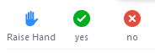
B8.ab: Individual
*note All HW8 due next Thursday but, Recommended to complete Q3 before submitting HW7.b

